Slide 1
Bridging Data Islands: Crafting a Semantic Search Oasis with Generative AI
By Gary Short
Darah AI Limited
Notes:
All content is copyright Darach AI Limited 2024. All rights reserved.
See notes for slide explanation where required.
Note: Due to NDA all code samples are only for the purpose of illustrating the point being made, it should not be assumed that they can be used in conjunction to form a working solution.
Please contact gary@darach.ai with any queries.

Slide 2
Guess who didn’t get the memo about flight puns?

Slide 3
Session Hygiene

Slide 4
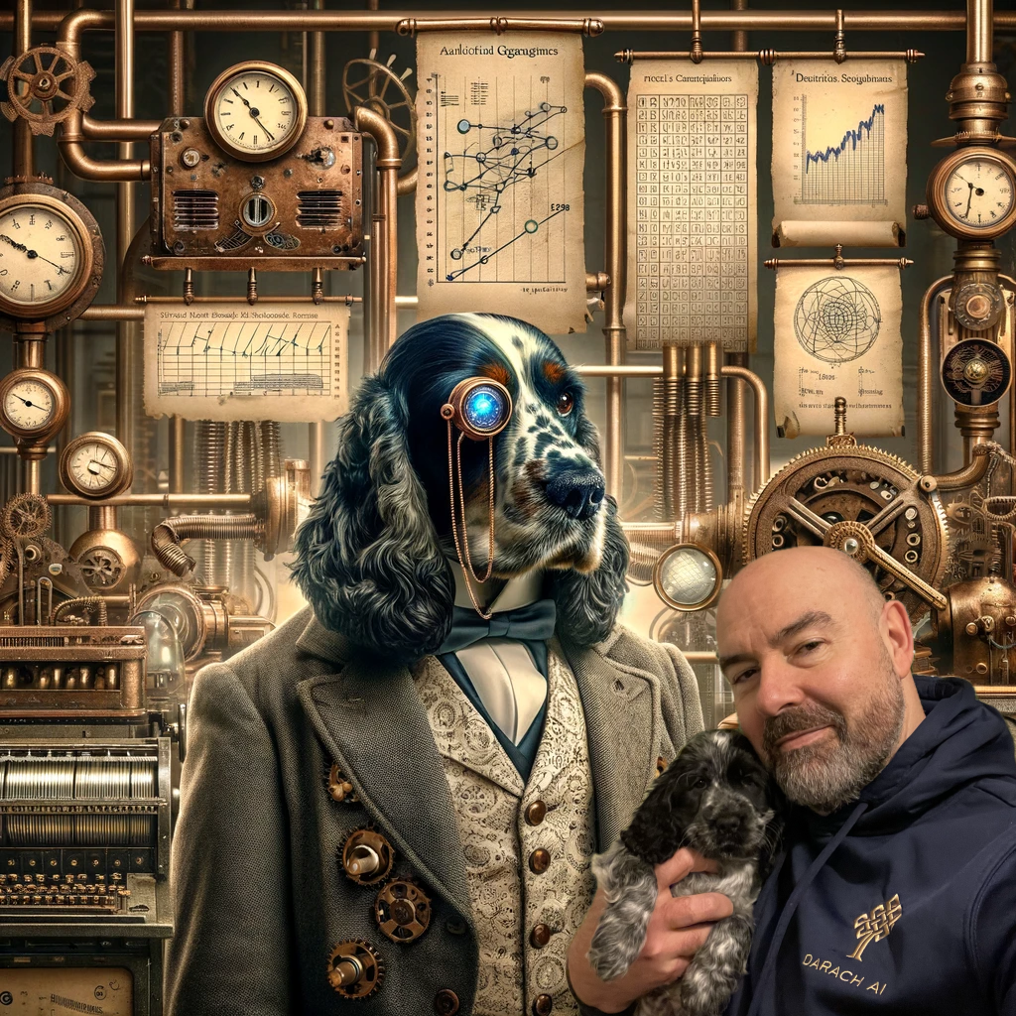





Introduction
Gary Short
Founder Darach.ai
Data science consultancy*
Socials
darach.ai.Scotland
darach.ai
garyshort
@garyshort (I wouldn’t though)
garyshort
Me and the ‘Probability Pup’

Slide 5
Data Science, what does that even mean, what do you actually do?

Slide 6
“I build internet scale data analytics platforms, and the teams to operate them, then I predict the future.”

Slide 7
“I build internet scale data analytics platforms, and the teams to operate them, then I predict the future.”
Notes:
Explain that predicting the future means different things to different companies. I can be what is the risk in this asset, how many widgets will I make next year, what will the price of coco beans be next year, etc.

Slide 8
What about you folks?

Slide 9
Let’s unpack the session title…

Slide 10
Bridging Data Islands: Crafting a Semantic Search Oasis with Generative AI

Slide 11
Bridging Data Islands: Crafting a Semantic Search Oasis with Generative AI

Slide 12
Bridging Data Islands: Crafting a Semantic Search Oasis with Generative AI

Slide 13
Bridging Data Islands: Crafting a Semantic Search Oasis with Generative AI

Slide 14
Data Island
Data is isolated
Caused by
Technical limitations
Privacy
Security
Organizational silos
Data is isolated
Caused by
Technical limitations
Privacy
Security
Organizational silos

Slide 15
Data Island
Data is isolated
Caused by
Technical limitations
Privacy
Security
Organizational silos
Data is isolated
Caused by
Technical limitations
Privacy
Security
Organizational silos

Slide 16
Sematic Search
Understands
Intent
Contextual meaning
Relationship between terms
Aids Natural language search
Understands
Intent
Contextual meaning
Relationship between terms
Aids Natural language search

Slide 17
Sematic Search
Understands
Intent
Contextual meaning
Relationship between terms
Aids Natural language search
Understands
Intent
Contextual meaning
Relationship between terms
Aids Natural language search

Slide 18
Generative AI
AI algorithm
Designed to create content
Art
Music
Text
Articles
Novels
Code
Human understandable answers
AI algorithm
Designed to create content
Art
Music
Text
Articles
Novels
Code
Human understandable answers

Slide 19
Generative AI
AI algorithm
Designed to create content
Art
Music
Text
Articles
Novels
Code
Human understandable answers
AI algorithm
Designed to create content
Art
Music
Text
Articles
Novels
Code
Human understandable answers

Slide 20
Let’s frame our problem space…
Notes:
The actual problem is under NDA so frame a problem in the same space. We need an organisation rapidly and messily decoupled from the enterprise, resulting in data silos and an organisation lacking in the BI skills provide/use/self-serve BI information.

Slide 21
Non-Disclosure Agreement

Slide 22

Welcome To ‘Garyopolus’
Notes:
The problem space is going to be public transport suddenly privatised from the metropolis of ‘Garyopolus’

Slide 23
The ‘rip out’ strategy leads to datastores similar to this…
Notes:
Enumerate the data silos

Slide 24
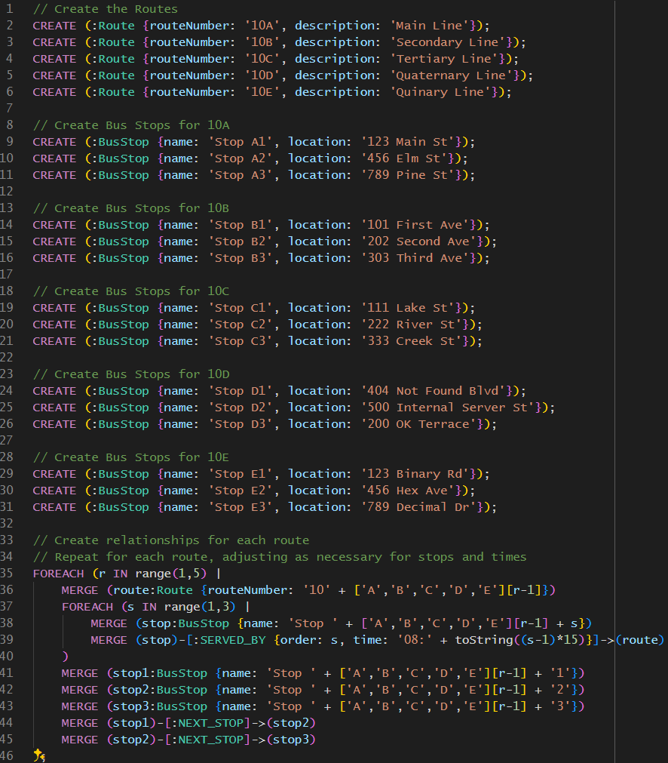
Notes:
Route data is held as a graph in Neo4J

Slide 25
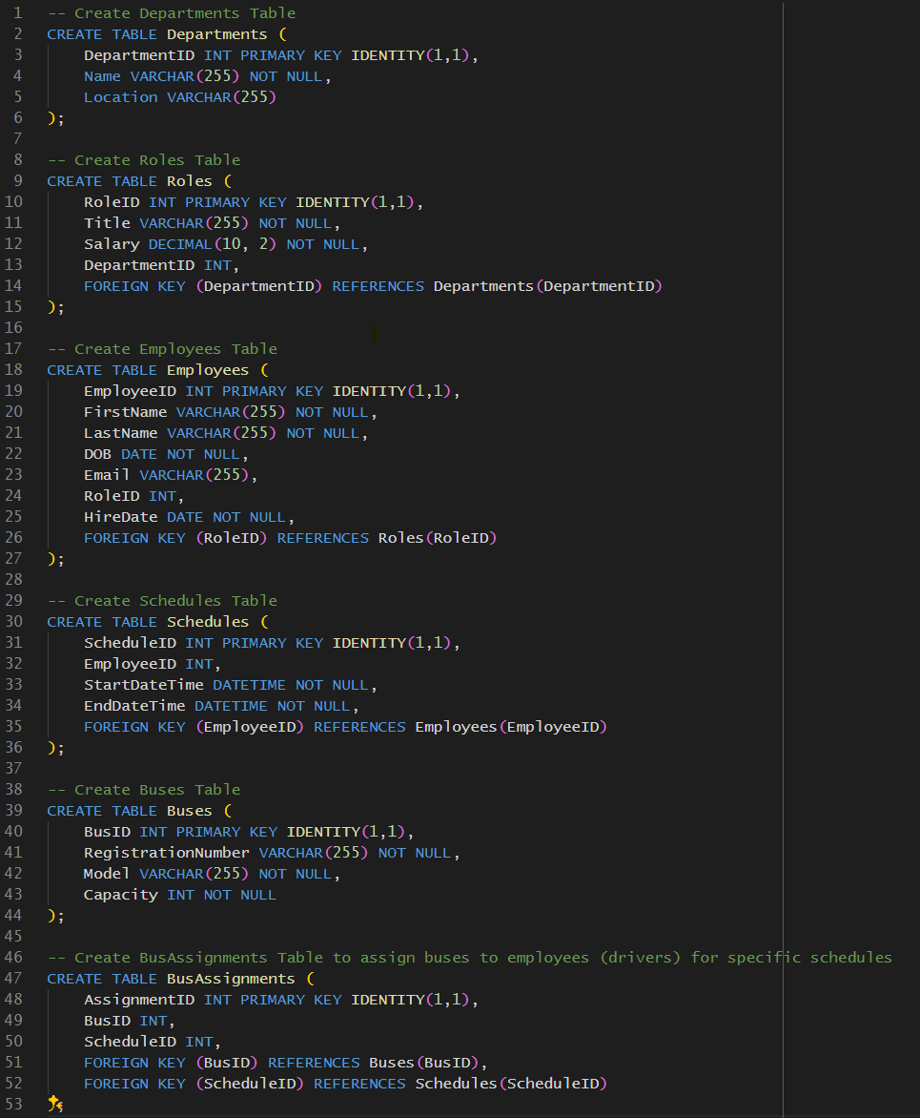
Notes:
HR data is held in Sql Server

Slide 26
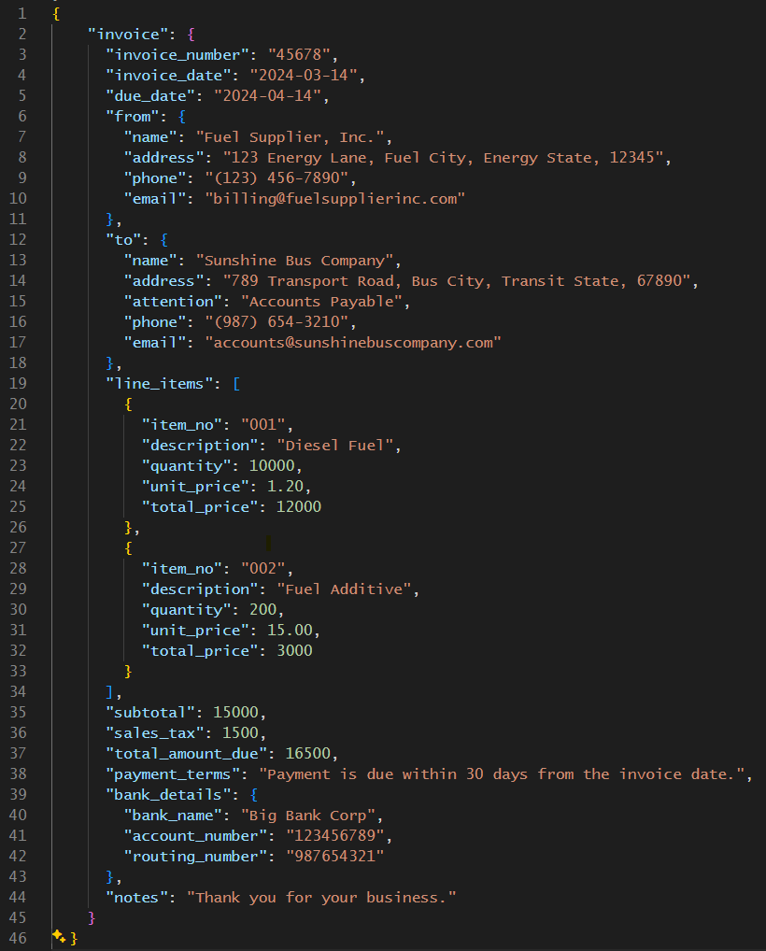
Notes:
Accounts data is held in MongoDB

Slide 27
Managers don’t speak any of that
Notes:
Managers don’t speak ‘data store’ nor do they speak ‘PowerBI’ and so can’t extract actionable information from the data silos.

Slide 28
Traditionally, you’ve had a choice…
Notes:
Traditionally the answer has been standard reports or output from a BI/Data Science team

Slide 29
Democratisation of Data Science
Notes:
We tried ‘democratising data science’ by training staff on dashboarding technology and then ‘letting them loose’ on the ODS; that worked about as well as you’d expect when the Spark/Hadoop cluster dumped 1.3TB of data onto the Tableau Server.

Slide 30
Azure Open AI to the rescue?
Notes:
Could generative AI be the answer; speaking ‘data store’ and explaining the result?

Slide 31
To the Bat Cave! …or at least the Azure Architecture Centre
Notes:
We want to use Azure AI Search to solve the data silo problem and OpenAI to solve the querying and explaining problem. Is there an Azure reference architecture for this type of solution?

Slide 32
When we got there, the cupboard was bare
Notes:
No there isn’t, so we’re amongst the first to try this solution, so we’ll just have to make it up as we go along.

Slide 33
It’s just like any other cloud data app… mostly
Build out the infrastructure
Ingest the data
Set up Azure AI Search
Build the search experience
Scalability and performance
Secure the application
Data privacy and compliance
Logging and monitoring
Curate your indexes
Audit search results
Notes:
This isn’t as big a problem as you think as most of the things you must do to fully architect this solution are the same as you’d do to architect any cloud data solution. You don’t get to skip it just cos you are using OpenAI, not does it suddenly become some kind of black magic just cos we’ve got GenAI in there.

Slide 34
It’s just like any other cloud data app… mostly
Build out the infrastructure
Ingest the data
Set up Azure AI Search
Build the search experience
Scalability and performance
Secure the application
Data privacy and compliance
Logging and monitoring
Curate your indexes
Audit search results
Notes:
These are really the only bits that change.

Slide 35
Step 1 – Build out the infrastructure
Let’s build an ODS

Slide 36
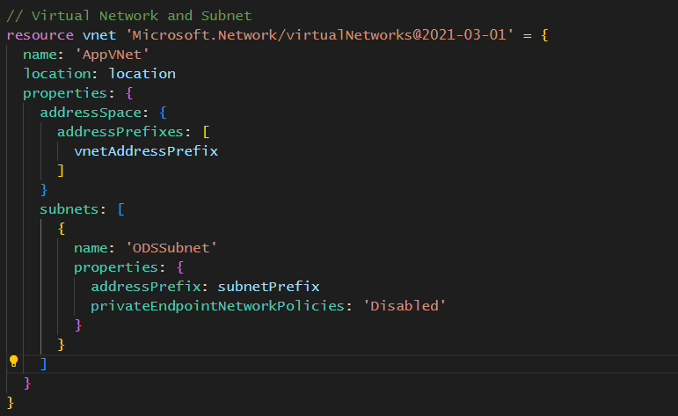
Create a vnet and subnet

Slide 37
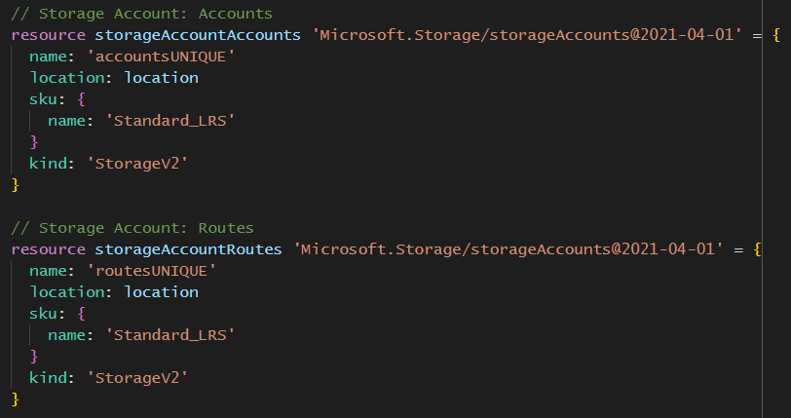
Create storage accounts

Slide 38
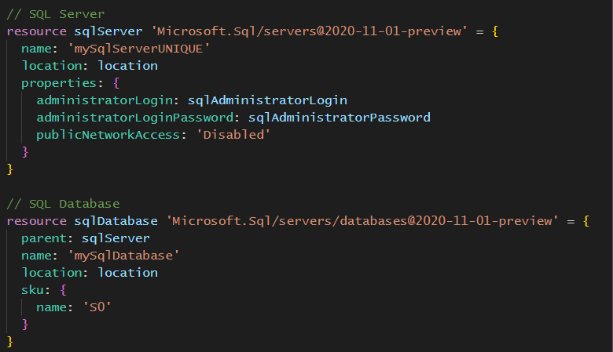
Create SQL Server and its database

Slide 39
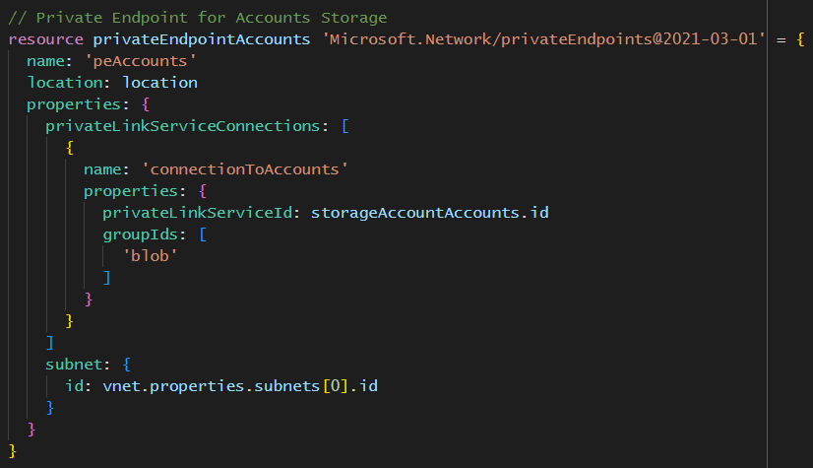
Set up private end point for ‘Accounts’ storage

Slide 40
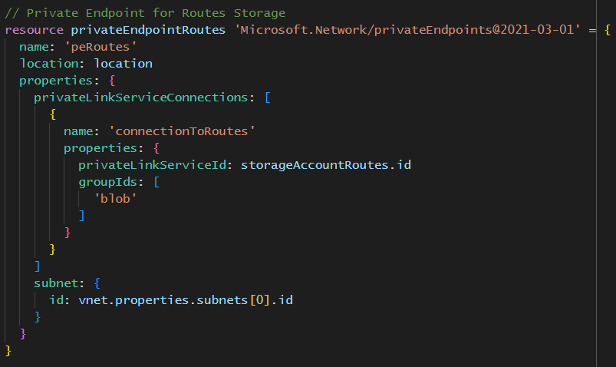
…and for ‘Routes’

Slide 41
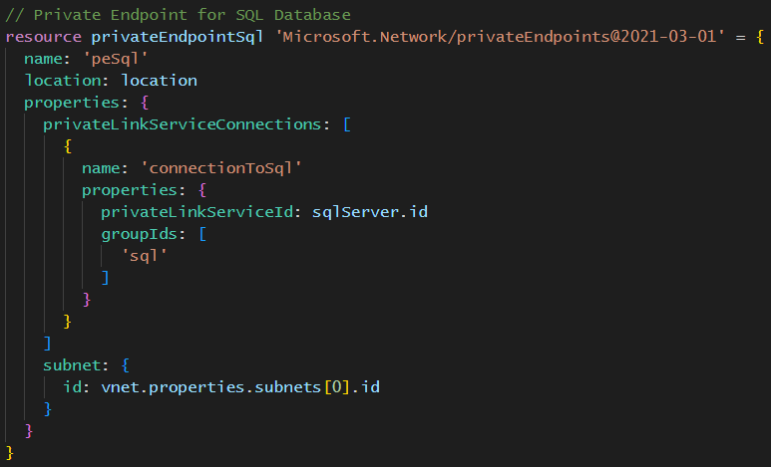
…and for the database

Slide 42
After building the infrastructure, create the database schema

Slide 43
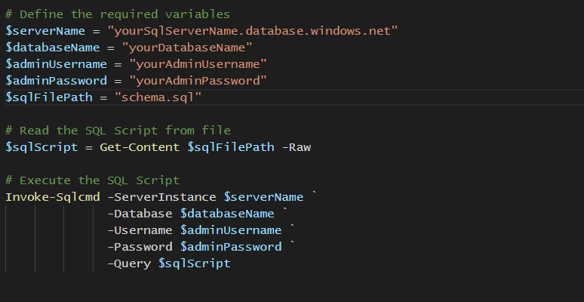
Define database schema

Slide 44
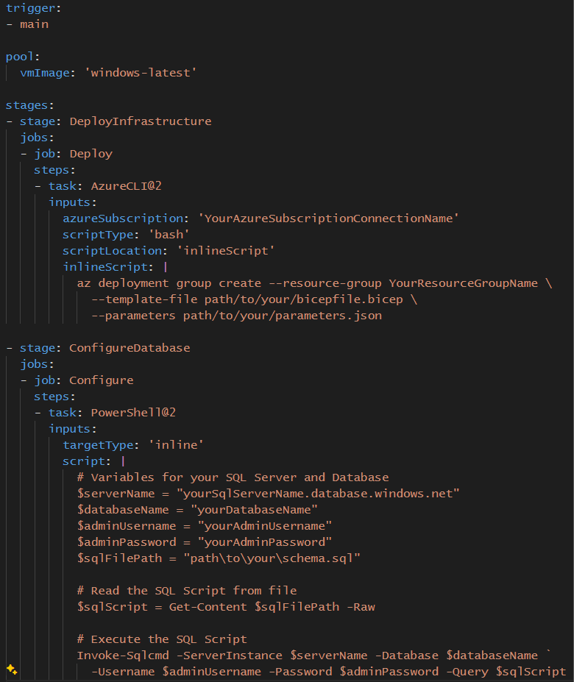
Wrap all that up in a DevOps Pipeline
Notes:
You don’t get to skip good devops practices just cos you’re using GenAI

Slide 45
Step 2 – Ingest the data

Slide 46
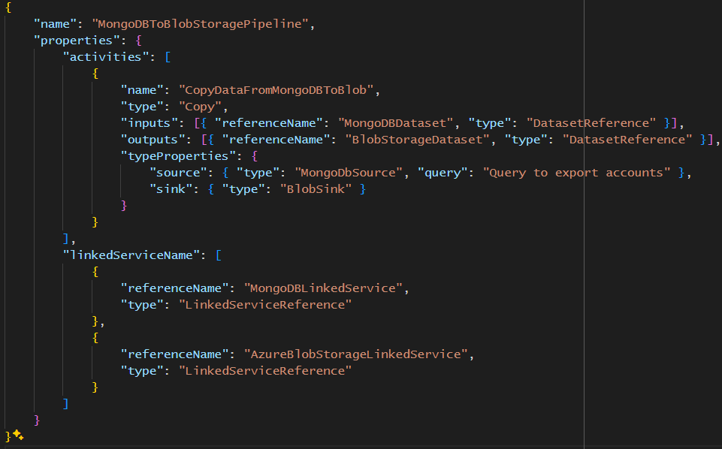
Data Factory job to import ‘Accounts’

Slide 47
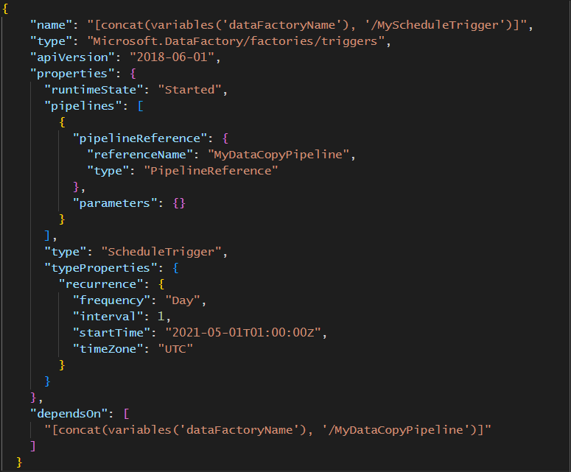
Trigger the ingestion daily

Slide 48
Step 3 – Set up Azure AI Search
Notes:
We will use this service to fix the data silo problem. We’ll take the heterogenous data and ‘stuff’ it into Azure AI Search so we can query it as if it’s a single homogeneous data store.

Slide 49
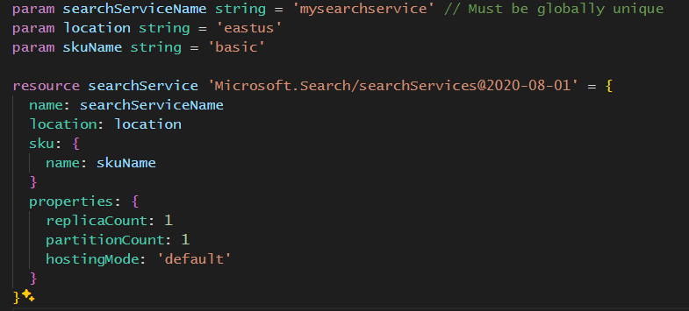
Create the service

Slide 50
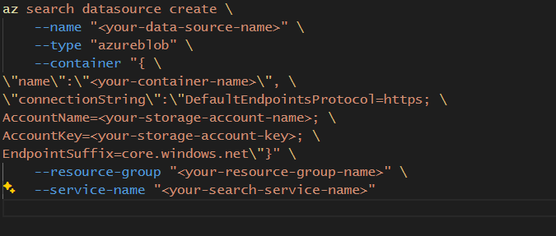
Define the data source(s) to index

Slide 51
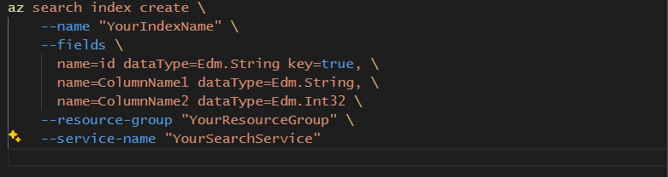
Create the index

Slide 52
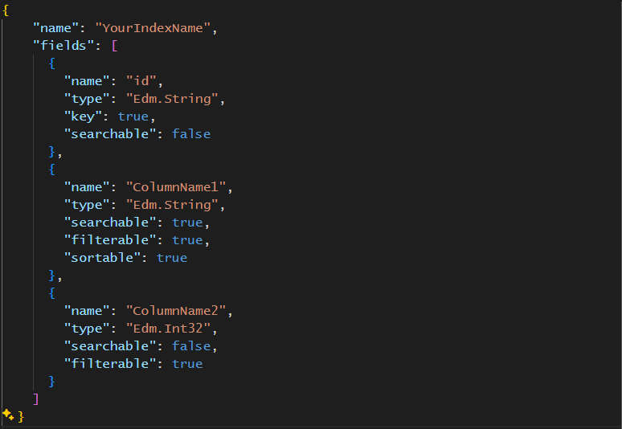
More complex index can be declared in json

Slide 53
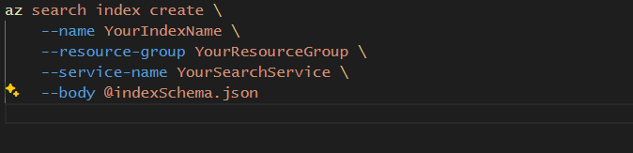
And create like so

Slide 54
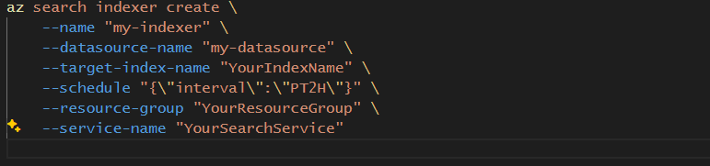
Create an indexer for the data store

Slide 55
Step 4 – Build the search experience
Notes:
Building the search experience includes the following tasks:
Ensure Azure AI Search returns the best possible answers to any given query.
Ensure OpenAI generates the best possible query text from the user’s question
Ensure OpenAI generates the best possible explanation from the returned ResultsObject.

Slide 56
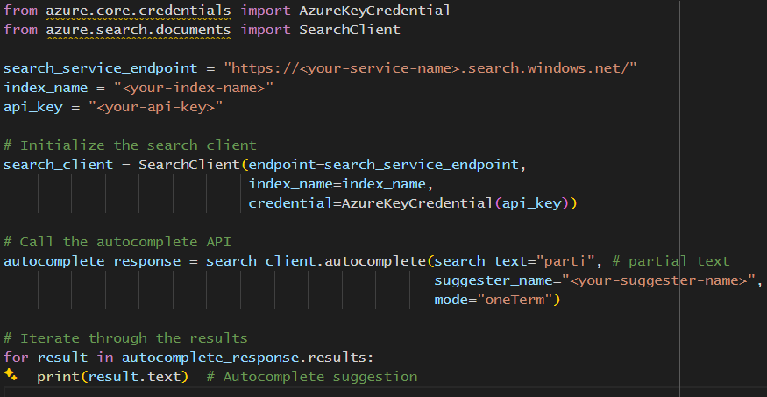
Use autocomplete
Notes:
Let’s spend the next few slides optimising Azure AI Search…

Slide 57
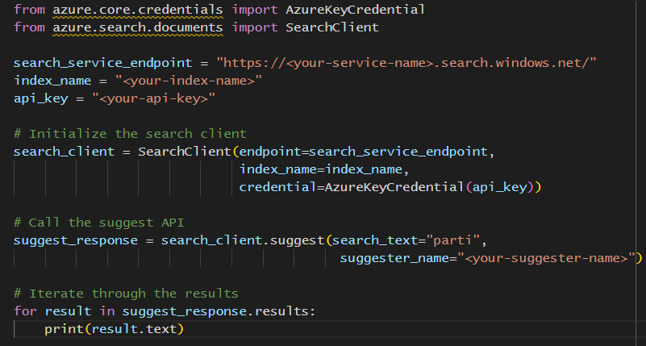
Use suggestions

Slide 58
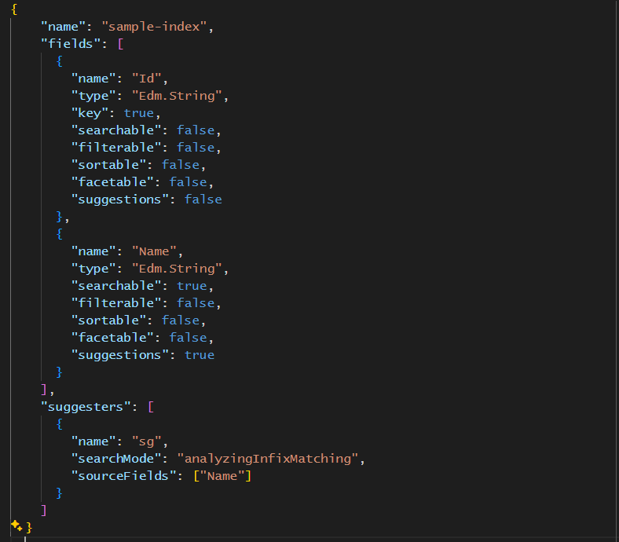
You must configure a ‘Suggester’ for this

Slide 59
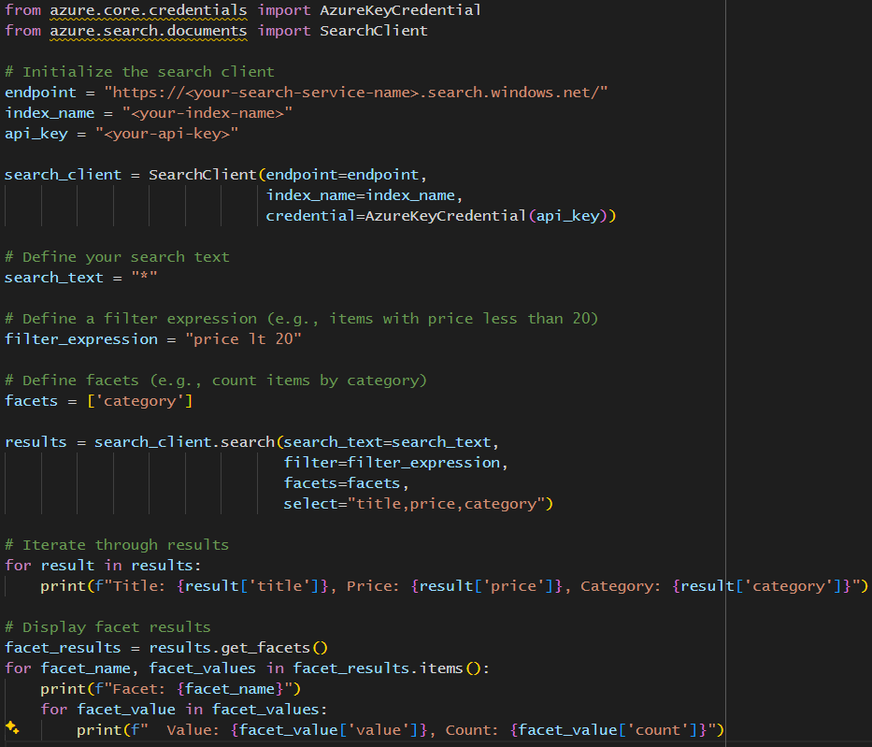
Handle search results with ‘filters’ and ‘facets’

Slide 60
What is a ‘Filter’?
Filters are used to refine search results based on certain conditions. They are applied to a search query to return only those results that meet specific criteria. For example, in an e-commerce application, a user might want to see only products within a certain price range or items available in their size. Filters typically operate on indexed fields and can use operations like equality, ranges, and more.

Slide 61
What is a ‘Facet’?
Facets, also known as faceted navigation or faceted search, allow users to explore search results through various dimensions or categories. Facets summarize data aspects, helping users to narrow down search results by applying multiple filters based on facet categories. For example, in an online bookstore, facets might include genre, author, publication year, and price range, enabling users to refine their search to find specific books of interest.

Slide 62
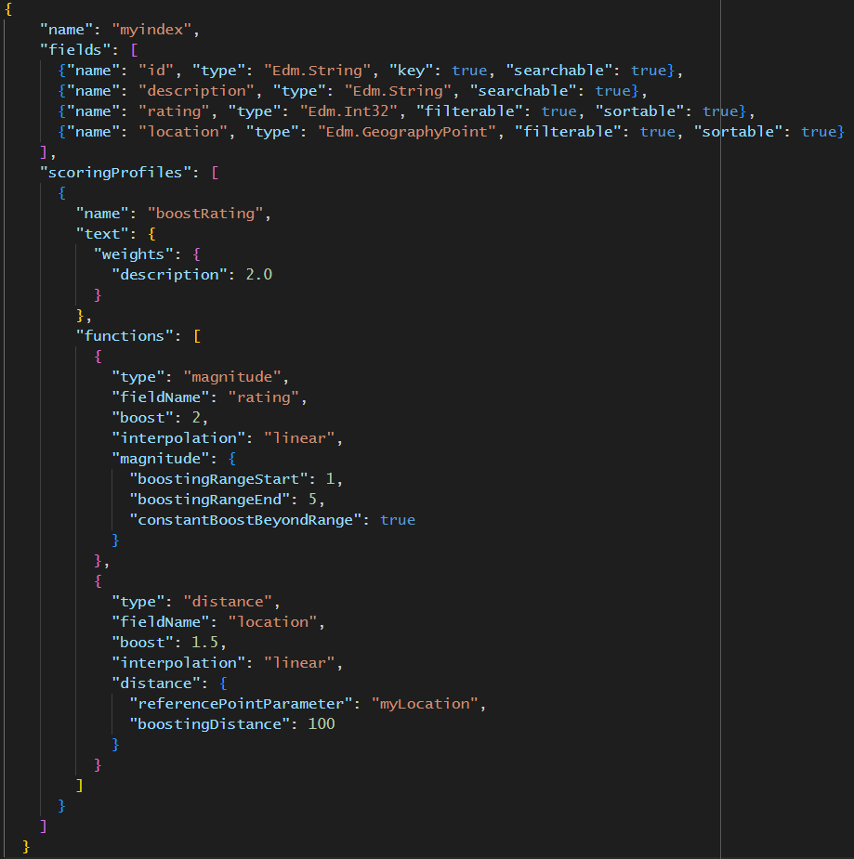
Use relevance tuning to improve experience

Slide 63
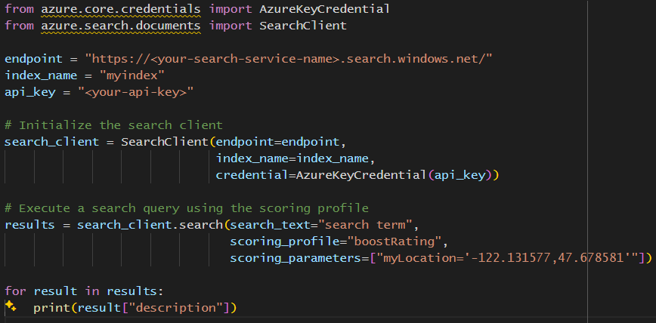
Use Scoring Profile in your search

Slide 64
Where have we gotten to?
Notes:
Now that Azure AI Search is configured to the best of our ability, we can turn our attention the OpenAI part of the solution.

Slide 65
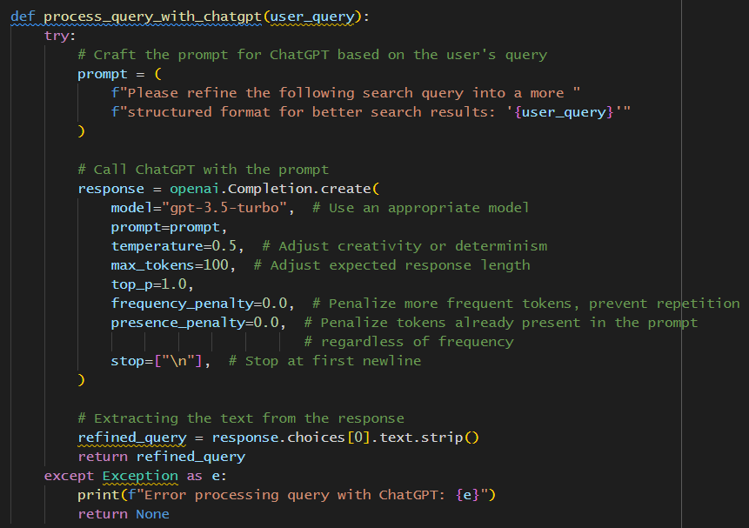
Ask ChatGPT to create a better query
Notes:
We use ‘prompt stuffing’ to generate a better query text by inserting the user’s query into an optimised prompt.

Slide 66
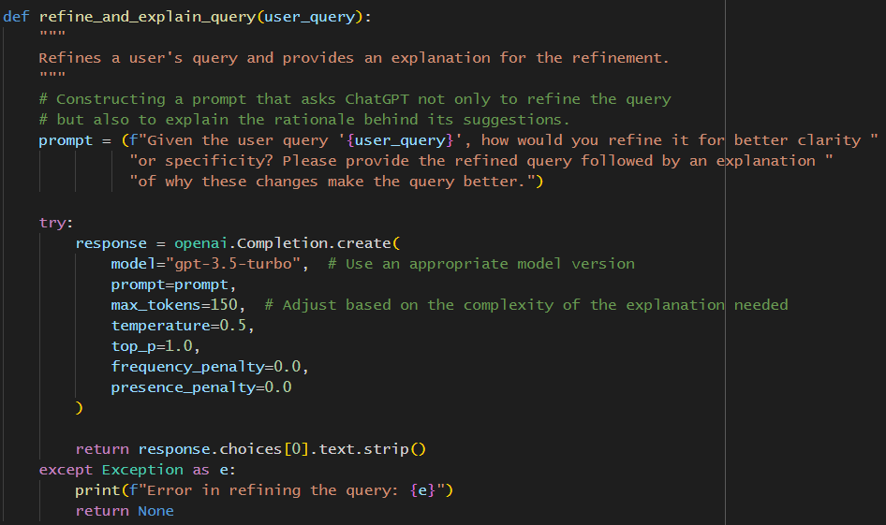
Use Prompt Engineering to refine this process
Notes:
We use ‘prompt engineering’ to ensure we are using the most optimal prompt. This prompt engineering is done ‘out of band’ and is achieved by a Darach AI proprietary workshop model where we elicit more and more optimal prompts from subject matter experts using Likert scale analysis of OpenAI provided explanation of it’s own optimisation. Improvements are made until users agree we have coalesced to the best solution. This proprietary methodology places some quantitative rigor around ‘prompt/intent engineering’

Slide 67
Create a response the user understands

Slide 68
Number of approaches
Retrieve then Read
Read Retrieve Read
Read Decompose Ask
Notes:
Explain to the audience that any LLM operates in one of three approaches. Explain what each of the approaches means.

Slide 69
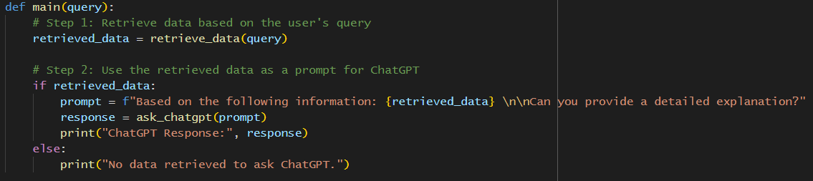
RTR – Get the data
Notes:
Show an example of RTR. Explain what this code is doing. Explain that the prompt used here undergoes the same ‘prompt engineering’ workshopping that the query prompt goes through..

Slide 70
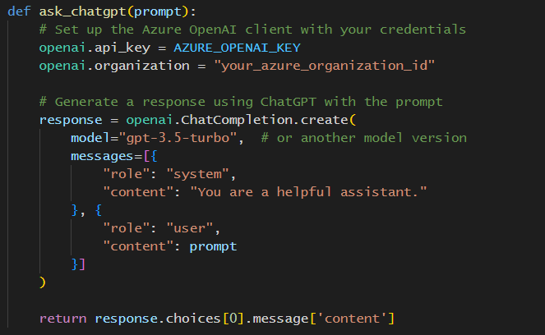
RTR – Turn the data into natural language
Notes:
Explain what LLM roles are and how we set up both the system and user roles to obtain the best possible explanation of the ResultObject returned from Azure AI Search

Slide 71
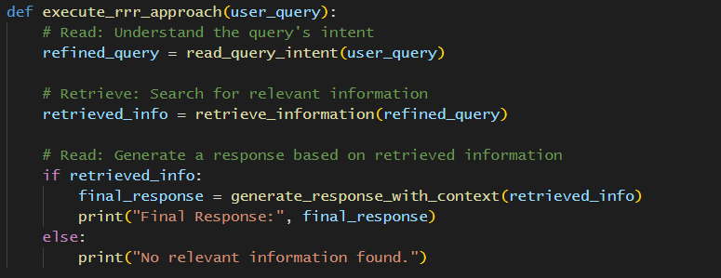
Read Retrieve Read
Notes:
In the next few slides show how the LLM understands the intent of the user’s search and that intent can be used to ascertain whether or not further queries have to be executed, either against the Azure AI Search corpus, or against allowed in house or third party data (when operating in the Read Retrieve Read approach)

Slide 72
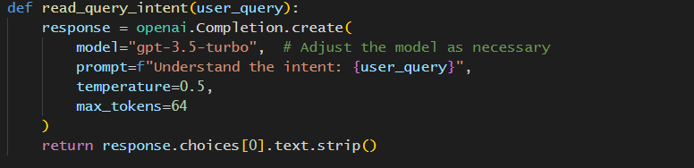
RTR – Understand the intent

Slide 73
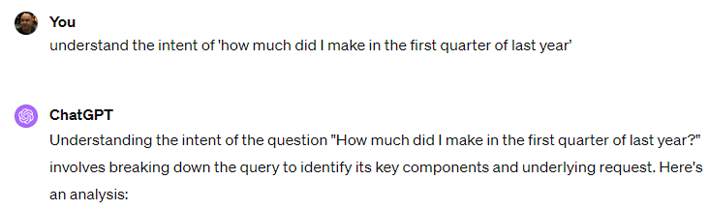
Example of understanding intent

Slide 74
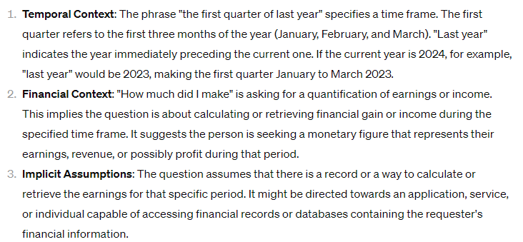
Example of understanding intent

Slide 75
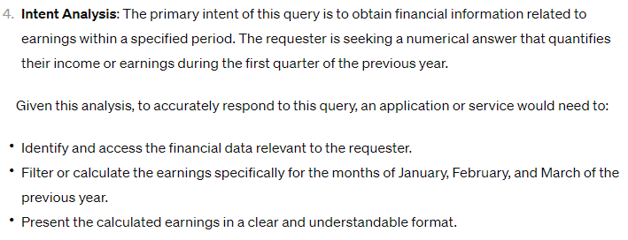
Example of understanding intent

Slide 76
Step 5 – Scalability and Performance
Notes:
For the rest of the talk, explain to the audience how we cannot avoid the rest of the ‘best practice’ for putting a cloud based product into production. Start with scaling a performance.

Slide 77
Partitions
Partitions are used to scale your search data horizontally. Each partition is a fully functional search engine with its own compute and storage resources. Azure Cognitive Search automatically distributes your data across multiple partitions when you increase the partition count.

Slide 78
Replicas
Replicas provide high availability and load balancing of query workloads. Increasing the number of replicas allows your service to handle more query volume by running searches in parallel across replicas.

Slide 79
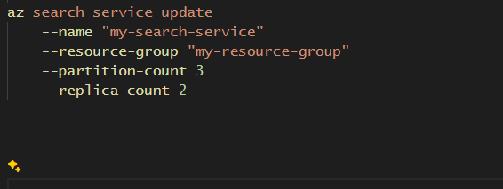
They can be resized on the fly
Notes:
Explain that services can have many indexes (this one has three) and whilst only one of the indexes may be under performing, partitions and replicas can only be increased at the service level, not at the index level; so either increase them and take the benefit for all indexes, including the underperforming one or, if the ‘bad’ index is several standard deviations from the others, then isolate that index in its own service.

Slide 80
You can use caching as normal
Notes:
In the next few slides, so the use of caching in a GenAI solution. Remember to cache the LLM improved search text and not the original query provided by the user.

Slide 81
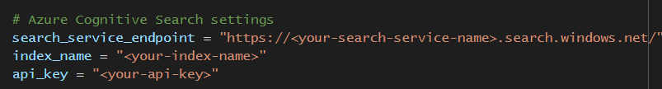
Set up Cognitive Search

Slide 82
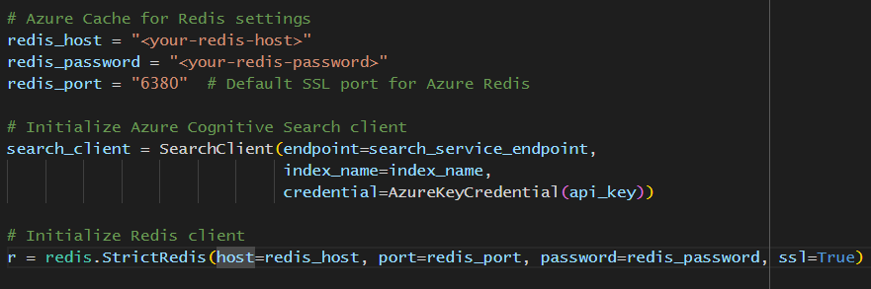
Set up Redis

Slide 83
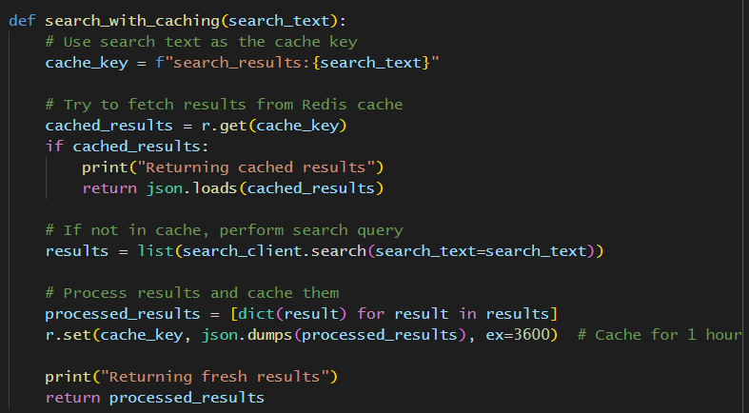
Search with caching

Slide 84
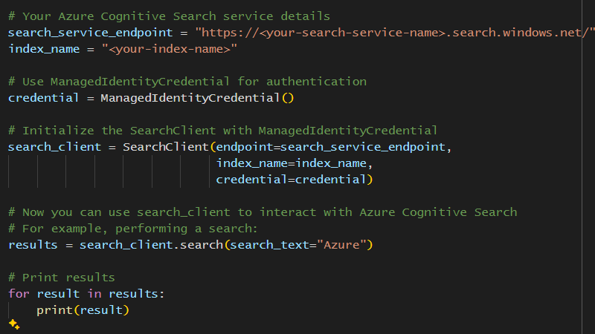
Step 6 – Secure your application
Notes:
Secure this application as normal

Slide 85
Step 7 – data privacy and compliance
Notes:
Remember you still have to comply with data privacy and compliance

Slide 86
Stuff you get for free
Encryption at rest
Encryption in transit

Slide 87
Stuff you get (almost) for free
RBAC – you need to set up the roles, but the infrastructure is there
Managed Identities – Azure AI Search supports Managed Identities
Network Security – The infrastructure support is there; you need to configure it.

Slide 88
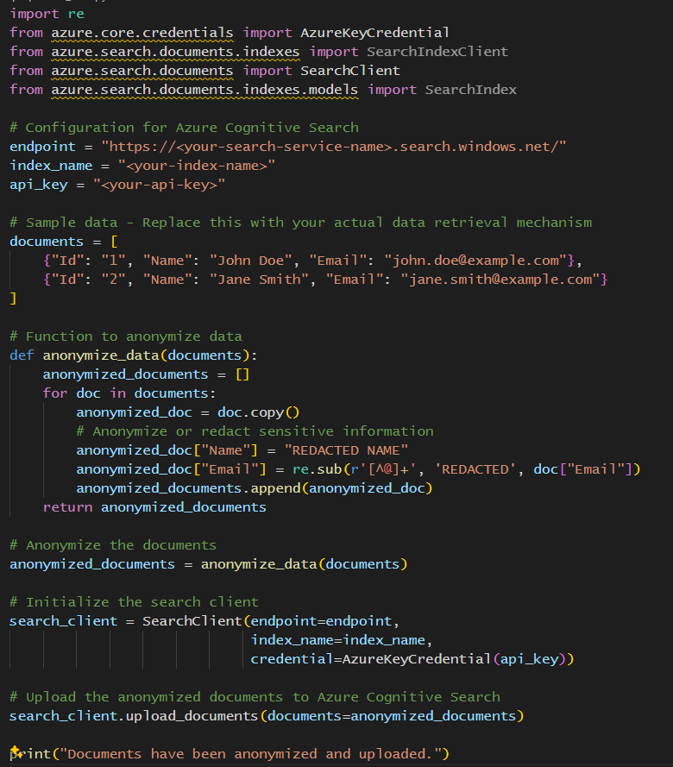
Preprocess data before you send it for indexing
Notes:
Explain that you can preprocess the data before uploading, either by doing it in a script and then uploading the data or, if you want your ingestion to be orchestrated by Data Factory, then codify your preprocessing in an Azure Function and call it from Data Factory.

Slide 89
Use Cognitive Skill to catch anything you missed
Notes:
Explain that you can also use skills to ‘clean’ your data.

Slide 90
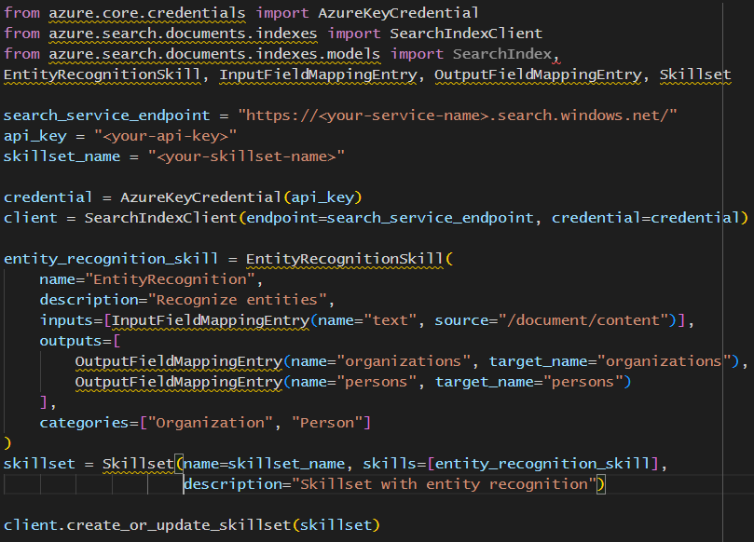
Define and create a Skillset

Slide 91
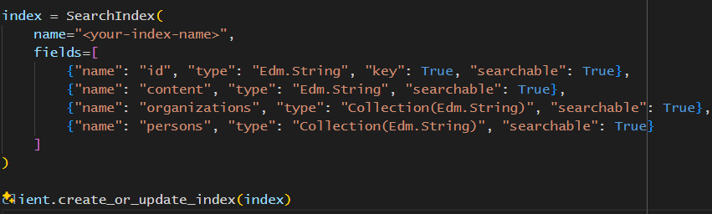
Create an Index

Slide 92
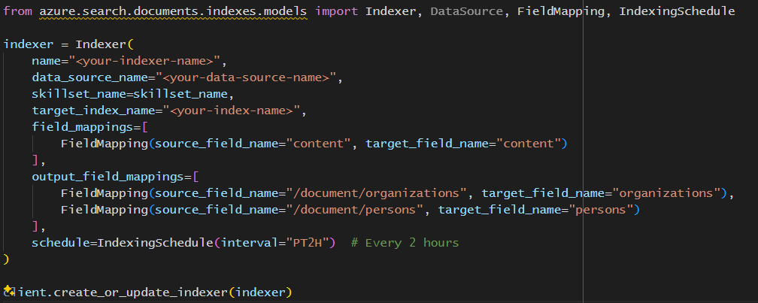
Create an Indexer with the Skillset

Slide 93
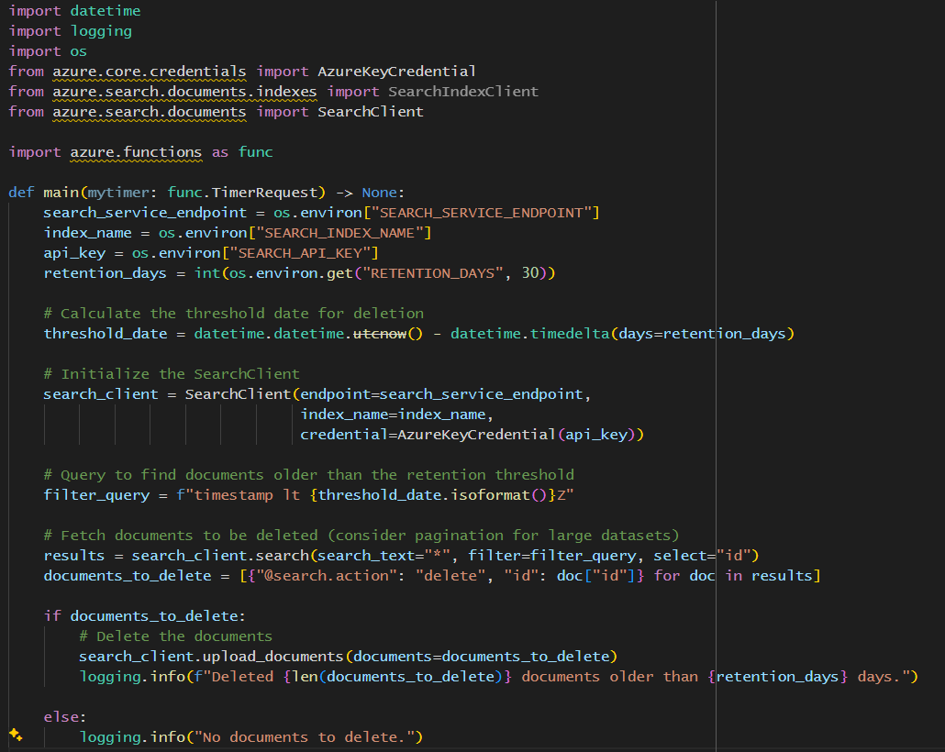
Implement data retention policy

Slide 94
Step 8 – logging and monitoring
Notes:
You have to log and monitor your application, just like normal, note this is different from auditing the performance of the prompt engineering and results explaining over time. You have to do both as there is a probability that they will suffer entropy over time.

Slide 95
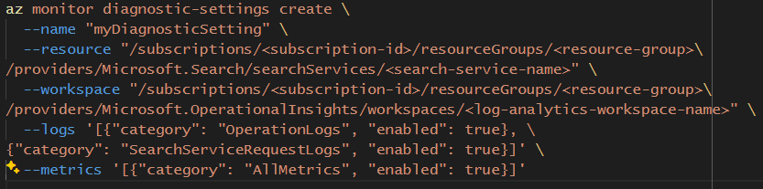
Enable diagnostic settings in Azure AI Search

Slide 96
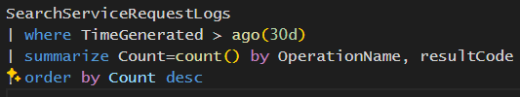
Query in Log Analytics

Slide 97
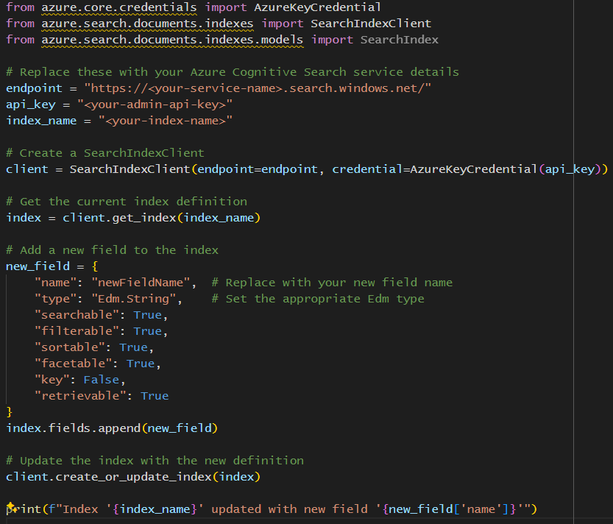
Step 9 – Curate the indexes
Notes:
The Azure AI Search indexes will also suffer entropy over time, so ensure you curate to maintain optimal performance.

Slide 98
Step 10 – Audit search result success
Notes:
This is where you monitor the success of the ‘prompt engineering’ of the querying and results explanation. If you detect entropy then redo the ‘prompt engineering’ workshops. Don’t forget to include the Azure AI Search side of things. In the next few slides demonstrate that the Scoring Profiles could also suffer entropy and how to fix it.

Slide 99
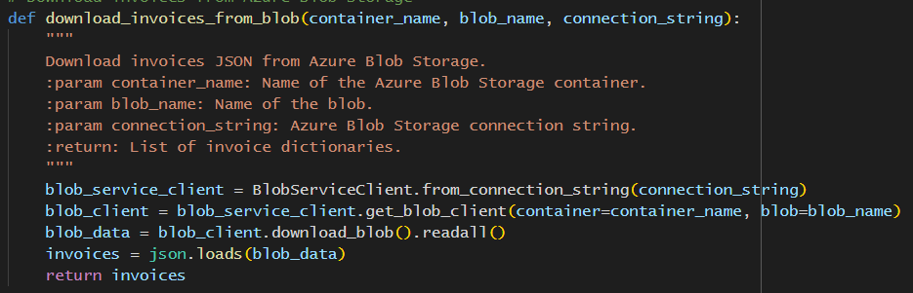
Write a function to download test data

Slide 100
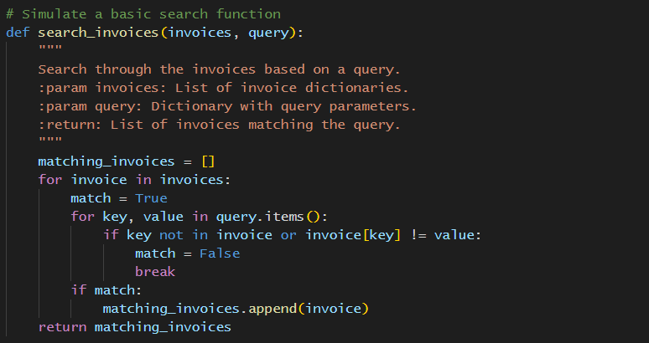
Mock the search functionality

Slide 101

Run your tests

Slide 102
Use the results to update the Scoring Profile

Slide 103
We made it! Questions?
Build out the infrastructure
Ingest the data
Set up Azure AI Search
Build the search experience
Scalability and performance
Secure the application
Data privacy and compliance
Logging and monitoring
Curate your indexes
Audit search results

